Slide 1

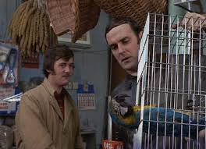
🕐 Starter
On your MWB, write an algorithm for the following:
Reginald wants a program that will tell him if his parrot needs to be returned to the pet store. Write a program that asks the user if their parrot is dead. If the parrot is dead, the program should inform Reginald that he should return his parrot to the store.
Extension
If Reginald says his parrot is not dead, it should keep asking until he agrees it is.

Slide 2

Learning Outcomes
Topic Question:
How do I code a computer?
Lesson Question:
How do I write an if statement?

Slide 3

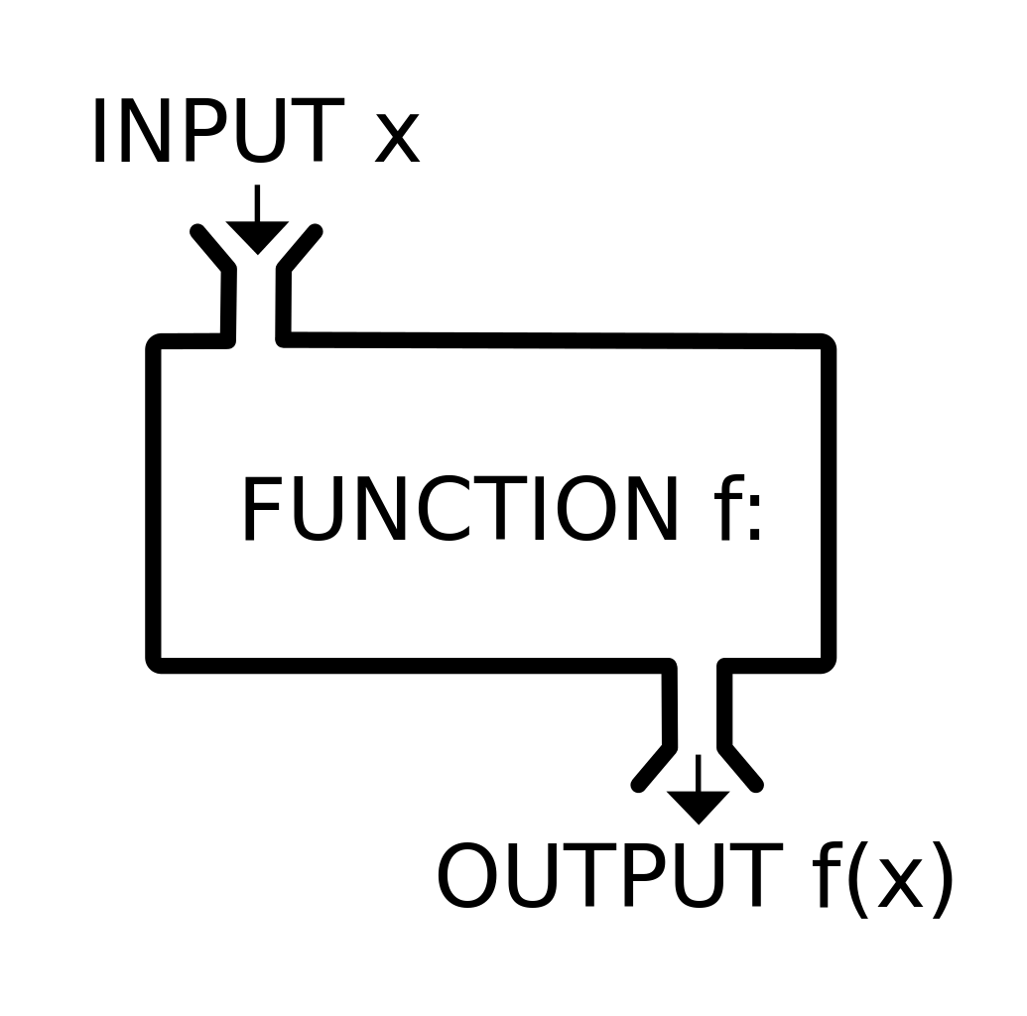


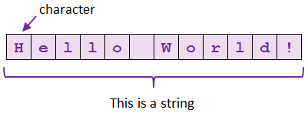
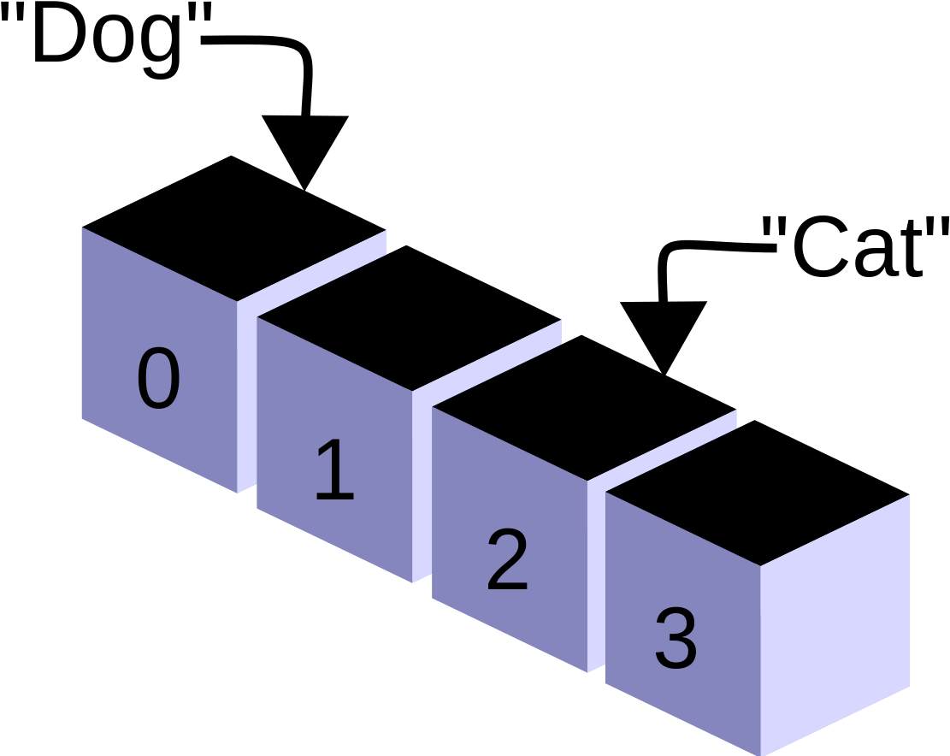


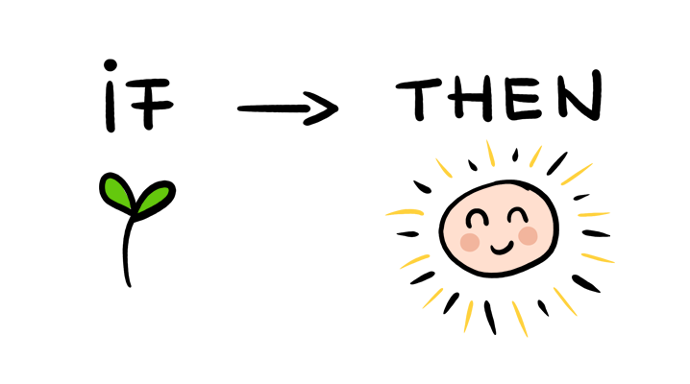
How do I write algorithms by hand?
Y11 - Algorithms
How do I write data to a file?
Practice
What are subprograms and how do I use them?
How do I use arrays?
When do I need to manipulate strings?
What are the different types of iteration?
How do I write an if statement?
Start
When should I use iteration?
How do I get input from a user?

Slide 4

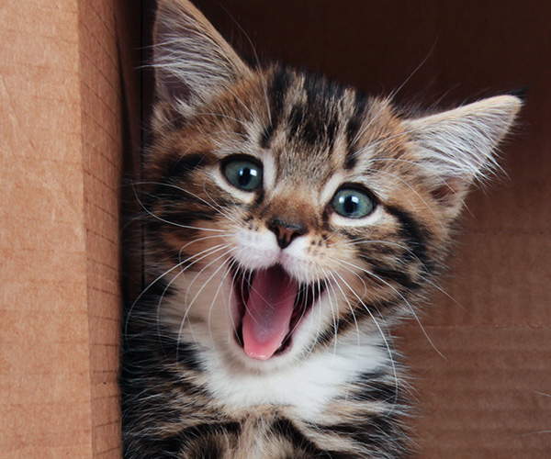
On your MWB, write an algorithm for the following:
Maria wants a program that can determine if her cat is happy or not.
Your algorithm should:
Ask “is the cat is purring?”
If the cat is purring, it should output “The cat is happy!”
If it is not purring, it should output “The cat is not happy.”
Then...
First ask if the cat’s tail is swishing. If it is, output “the cat is angry...”
Make your program ask about five cats before exiting.

Slide 5
On your MWB, write an algorithm for the following:
Bartholomew wants to write a program that will provide a grade for his exam score. If he scores over 60, he will get an A. If he scores over 40, he will get a B. if he gets lower than this he will get a C.
Write an algorithm that will ask Bartholomew for his score, and output the correct grade, and ONLY the correct grade.
Extension
Your algorithm should work out how close Bartholomew is to the next grade.

Slide 6

On your MWB, write an algorithm for the following:
A computer has to make a decision on if the roof of Wimbledon needs to be shut. It should do this if it is currently raining, and if the rain is going to last for another 60 minutes or more.
Write an algorithm which:
Asks the user to enter the number of minutes it is going to rain
Outputs “close roof” when appropriate
Outputs “open roof” when appropriate
Extension
Your algorithm should keep asking until the roof is closed

Slide 7

On your MWB, write an algorithm for the following:
A computer has to output the correct number of cakes and sandwiches for an afternoon tea. There should be 1 sandwich and 3 cakes for each person. If there are more than 3 people, there needs to one less cake overall. For example if there are 4 people, there should be 4 sandwiches and 11 cakes.
Write an algorithm which:
Asks the user to enter the number of people for the afternoon tea
Calculate and output the correct number of cakes with an appropriate message
Calculate and output the correct number of sandwiches with an appropriate message.
Extension
Put your program in a loop. When someone types in “x” it should output the number of cakes and sandwiches needed for all customers.

Slide 8
On your MWB, write an algorithm for the following:
Write a quiz program that asks 3 questions about the CPU architecture, RAM & ROM and Virtual memory.
Keep track of the score
Then…
After a student has completed the quiz, ask the questions they got incorrect again.

Slide 9

numMinutes = input ("How many minutes?")
raining = input ("Is it raining?")
1 mark
numMinutes = input ("How many minutes?")
raining = input ("Is it raining?")
if numMinutes >= 60 and raining == "yes"
print("Close the roof!")
else
print("Keep it open!")
3 marks!

Slide 10
q1= input("Does the program counter increment after
the decode part of the FDE cycle?")
q2 = input("What does MAR stand for?")
score = 0
if q1 == "no" then
print("Correct!")
score = score + 1
else
print("Incorrect")
endif

